Slide 1
Modeling

Slide 2
Definition
Models are forms of description often adopted in software development
It must be capable of representing the information that:
software transforms
the architecture and functions that enable the transformation to occur
the features that users desire
the behavior of the system as the transformation is taking place
Models must accomplish these objectives at different levels of abstraction—first depicting the software from the customer’s viewpoint and later representing the software at a more technical level

Slide 3
Modeling vs Design
Design is coming up with the idea for the function or shape, Modeling is trying to make the design come to life
Typically a model is a prototype of an end product you’re looking for. It gives a visual or virtual picture of your product or software.
Design defines how your product should work, what features do you want in the product, how do you want the look and feel of product.

Slide 4
Analysis modeling
One view of requirements modeling, called structured analysis, considers data and the processes that transform the data as separate entities.
Data objects are modeled in a way that defines their attributes and relationships.
Processes that manipulate data objects are modeled in a manner that shows how they transform data as data objects flow through the system.
A second approach to analysis modeled, called object-oriented analysis, focuses on
the definition of classes and
the manner in which they collaborate with one another to effect customer requirements.

Slide 5
Data Modeling
If software requirements include the need to create, extend, or interface with a database or if complex data structures must be constructed and manipulated, the software team may choose to create a data model as part of overall requirements modeling.
A software engineer or analyst defines all data objects that are processed within the system, the relationships between the data objects, and other information that is pertinent to the relationships.

Slide 6
What is a Data Object?
a representation of almost any composite information that must be understood by software.
composite information—something that has a number of different properties or attributes.
width (a single value) would not be a valid data object, but dimensions (incorporating height, width, and depth) could be defined as an object.
can be an external entity (e.g., anything that produces or consumes information), a thing (e.g., a report or a display), an occurrence (e.g., a telephone call) or event (e.g., an alarm), a role (e.g., salesperson), an organizational unit (e.g., accounting department), a place (e.g., a warehouse), or a structure (e.g., a file).
The description of the data object incorporates the data object and all of its attributes.
A data object encapsulates data only—there is no reference within a data object to operations that act on the data.

Slide 7
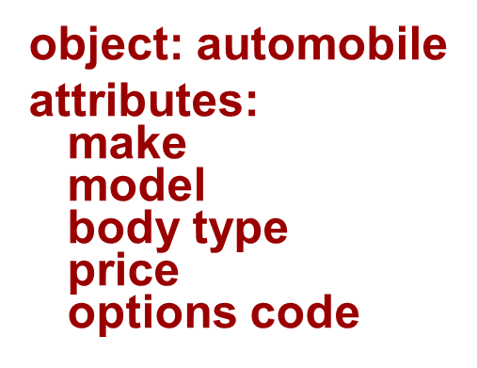
Data Objects and Attributes
A data object contains a set of attributes that act as an aspect, quality, characteristic, or descriptor of the object.

Slide 8
Data Objects and Object-Oriented Classes—Are They the Same Thing?
A data object defines a composite data item; that is, it incorporates a collection of individual data items (attributes) and gives the collection of items a name (the name of the data object).
An object-oriented class encapsulates data attributes but also incorporates the operations (methods) that manipulate the data implied by those attributes.
Classes communicate with one another via messages, they can be organized into hierarchies, and they provide inheritance characteristics for objects that are an instance of a class.

Slide 9
Class-Based Modeling
Class-based modeling represents:
objects that the system will manipulate
operations (also called methods or services) that will be applied to the objects to effect the manipulation
relationships (some hierarchical) between the objects
collaborations that occur between the classes that are defined.
The elements of a class-based model include classes and objects, attributes, operations, CRC models (Class Responsibility Collaboration (CRC) model is a low-tech technique for describing how an application, system, module, or process interacts with other components and "Actors), collaboration diagrams and packages.

